Slide 1
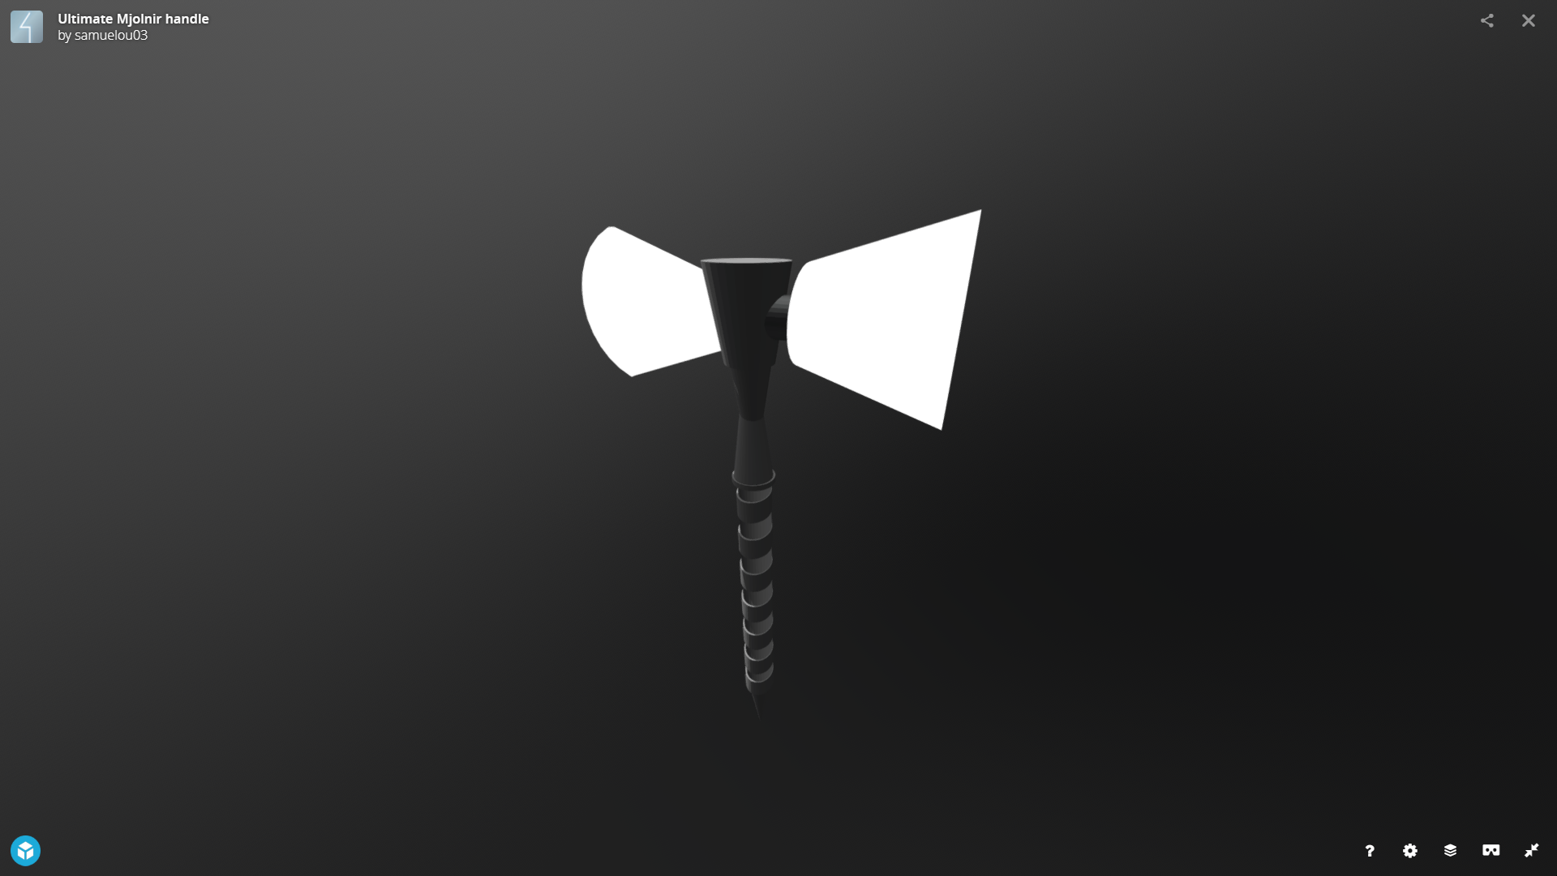
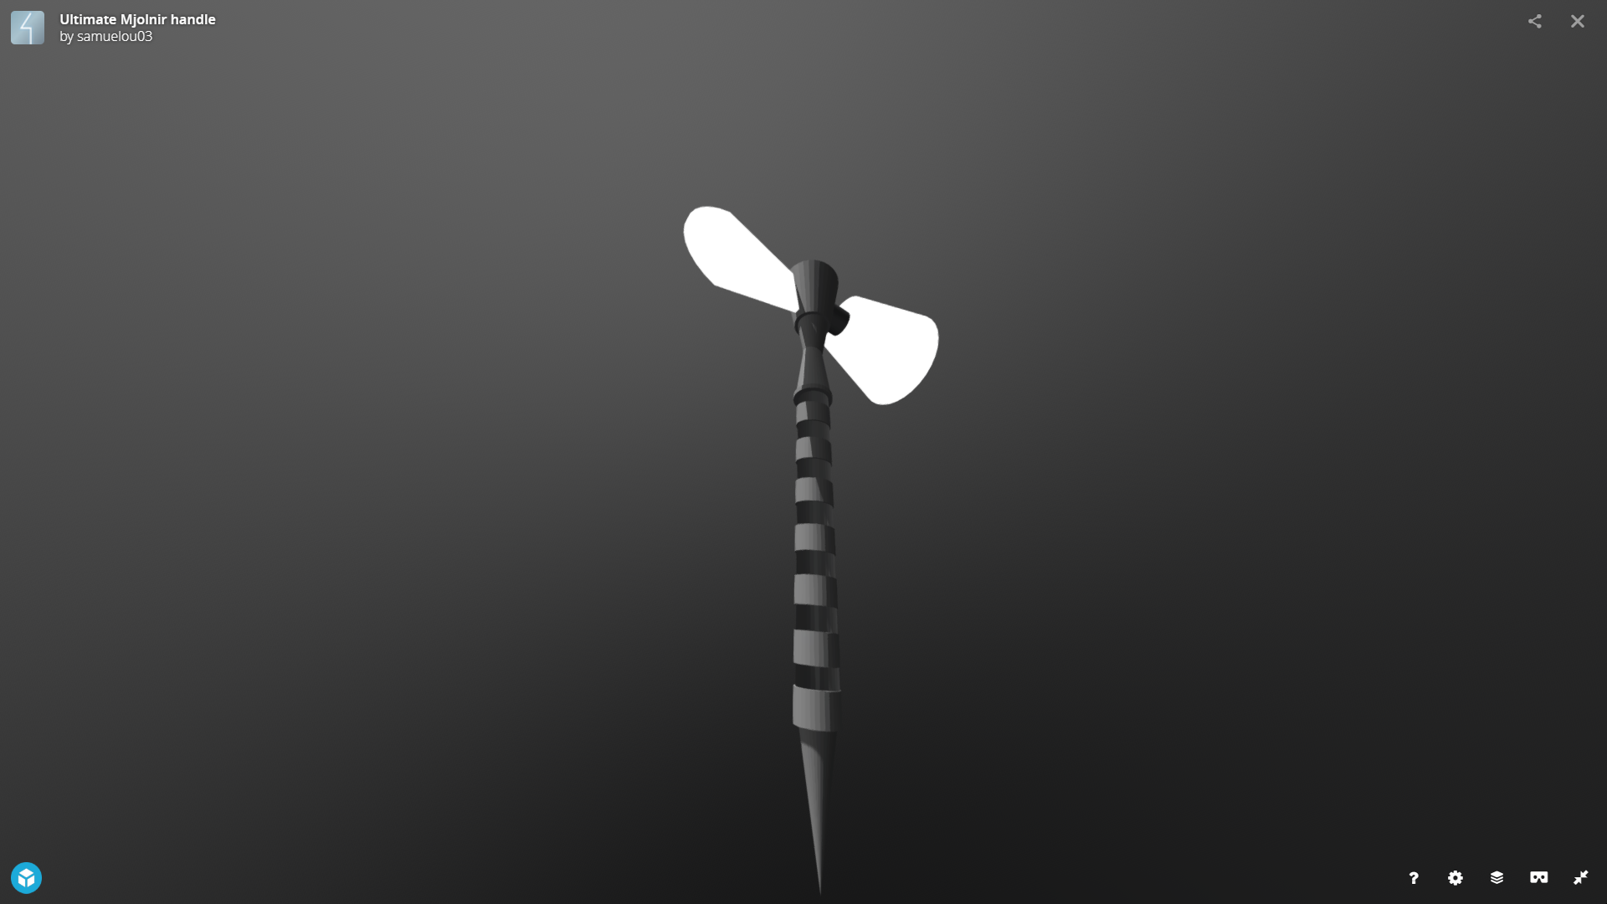
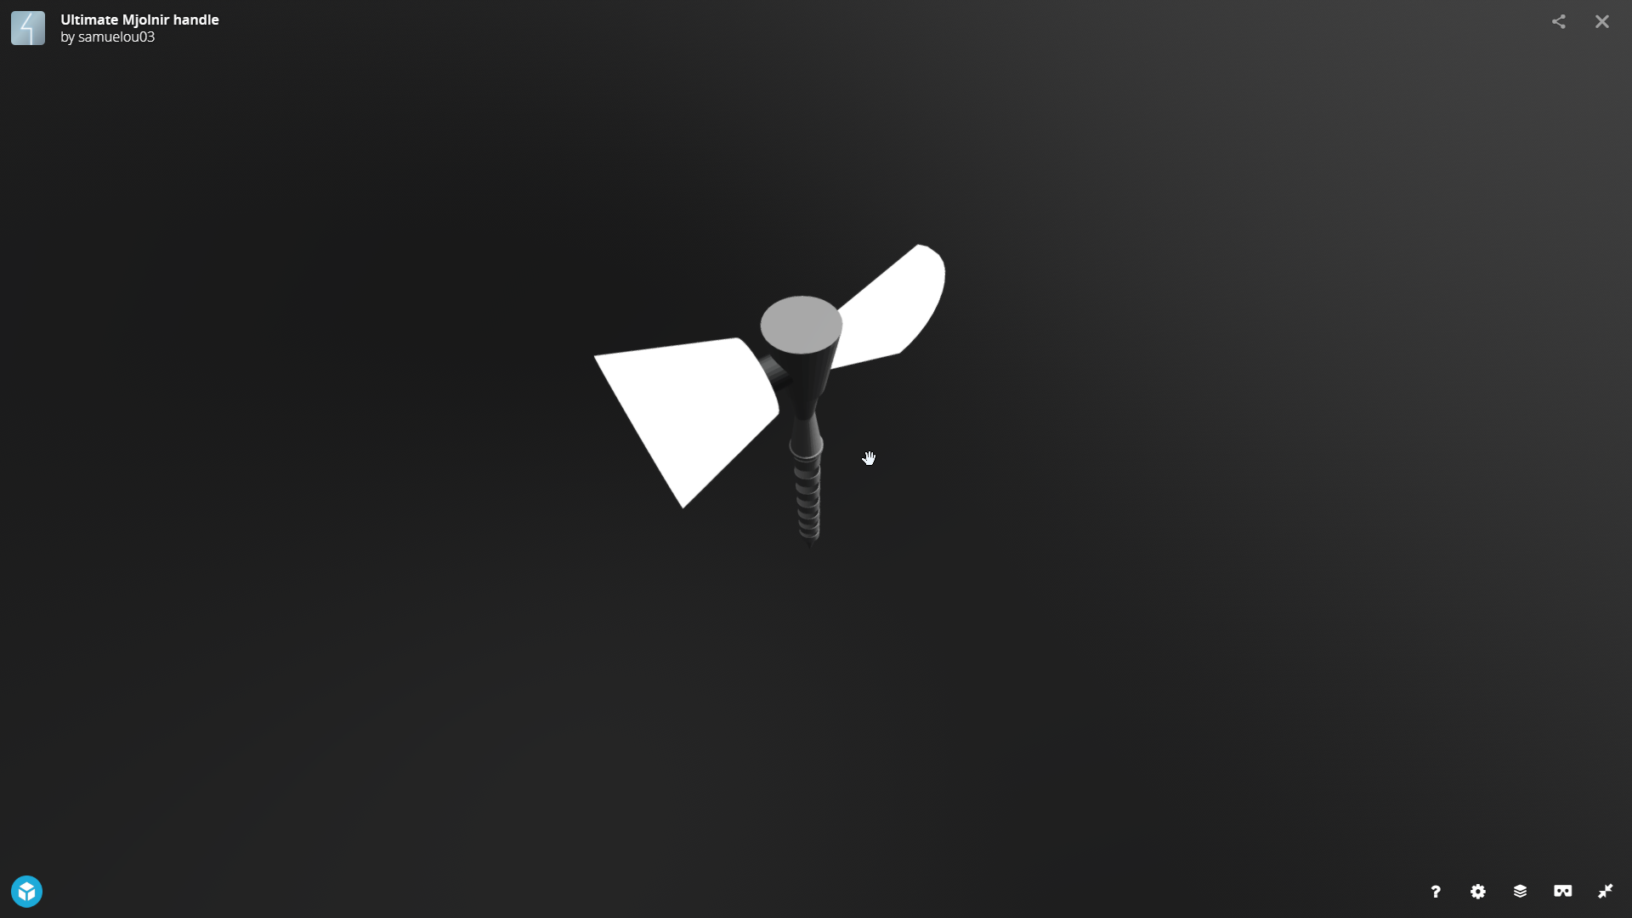
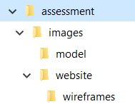
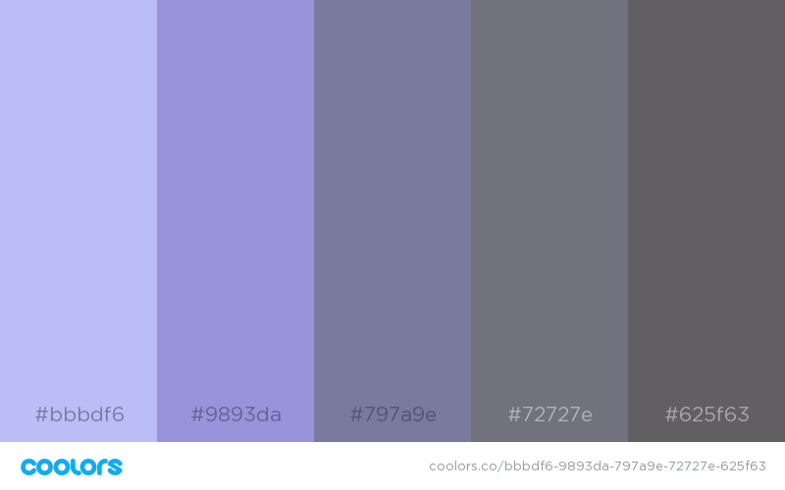

1.42 Evidence Poster – Samuel Ou 2018
3D Model Snapshots
Folder management
Colour theme
coolors.co/bbbdf6-9893da-797a9e-72727e-625f63
Uses of colour palette

